Slide 1

Clocks App
Group 3
Prepared By:
Brian Ramirez, Rachel Arellano, Eric Lozano, Eduardo Terrazas

Slide 2
Our App
Contains all the basic features of an alarm clock app such as:
Alarm
StopWatch
Timer
But also adds a special feature of a pomodoro timer
Pomodoro is a technique of using a timer to break up work into intervals separated by short breaks

Slide 3
Features Overview
Features Implemented:
Navigation
Firebase
Room(local)
ViewModel and LiveData
Recycler View
Features Still In Progress:
Permissions
Material Design
Notifications
Fragments
Unit Testing

Slide 4
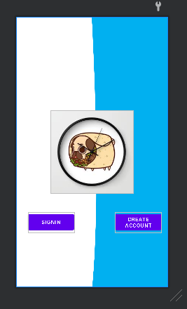
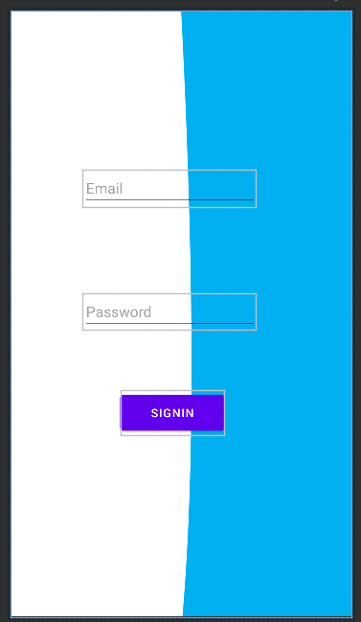
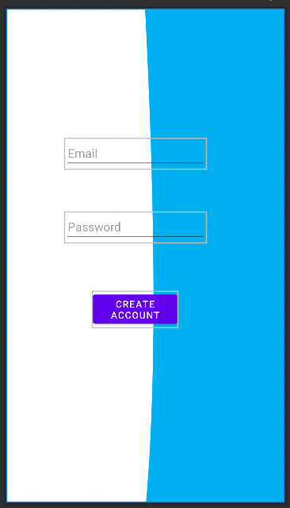
Main Page, Sign In, and Create Account

Slide 5
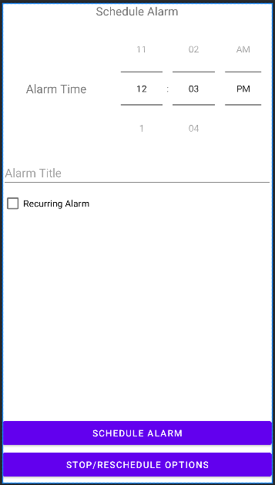
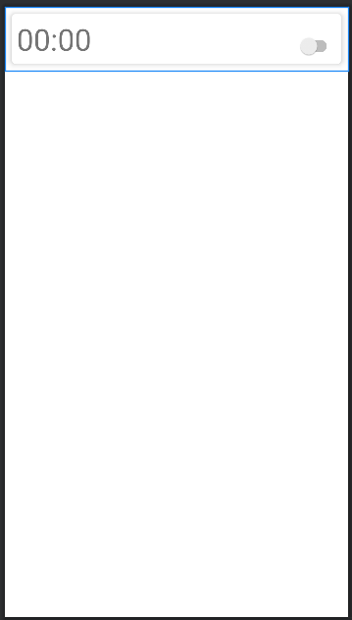
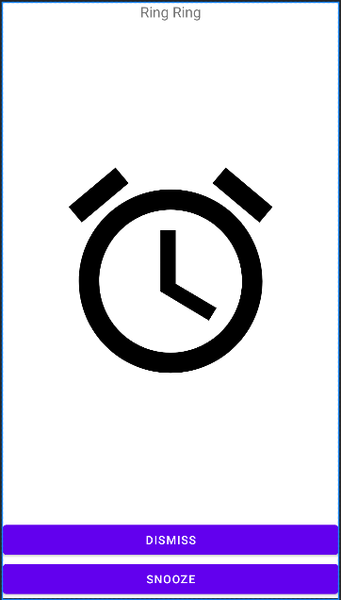
Alarm Clock

Slide 6
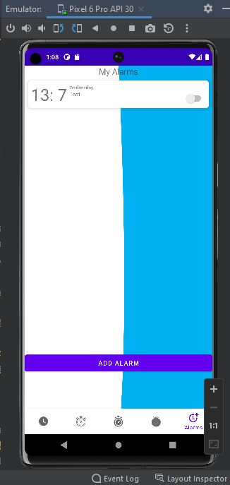
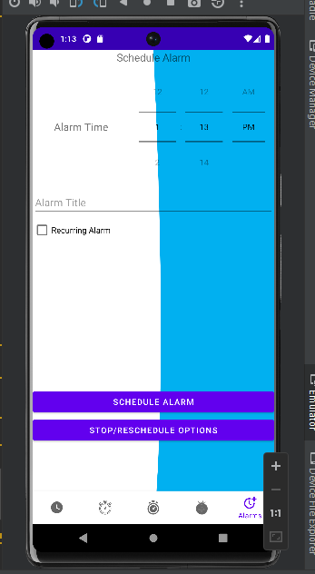
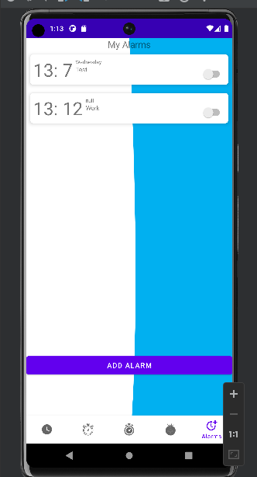
Room Database

Slide 7
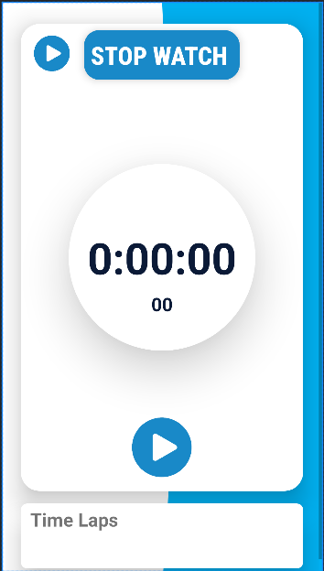
StopWatch

Slide 8
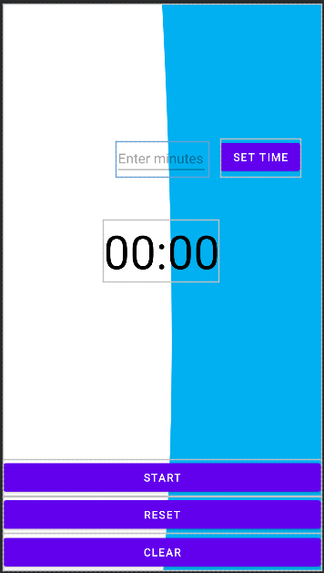
Timer

Slide 9
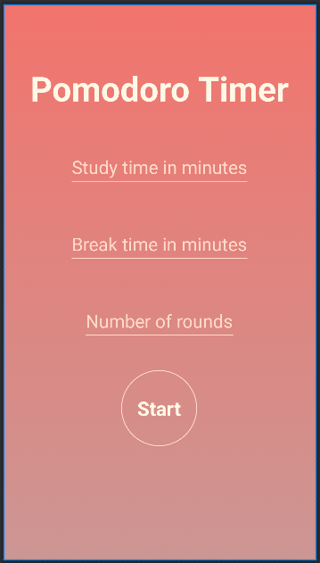
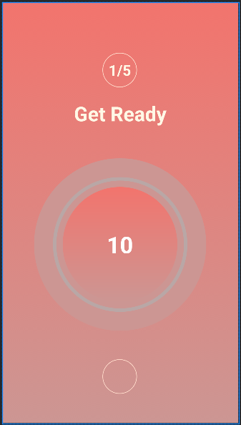
Pomodoro

Slide 10
Challenges & Takeaways
Fragments
Room
Binding
Organization
ViewModel
Notifications

Slide 11
Demo Video
https://drive.google.com/drive/folders/1taSy8vKisR5IS2pvbgylrFWoFD2XFUye?usp=share_link

